Slide 1

MACHINE LEARNING REGRESSION
POLYNOMIAL REGRESSION

Slide 2

POLYNOMIAL REGRESSION: INTUITION
Polynomial regression models the relationship between the independent variable X and the dependent variable Y as an 𝑛𝑡ℎ degree polynomial in X
$$y=b_{0}+b_{1}∗x+b_{2}x^{2}+..+b_{n}x^{n}$$
DEPENDANT VARIABLE
INDEPENDANT VARIABLE
SALARY ($)
YEARS OF EXPERIENCE

Slide 3
POLYNOMIAL REGRESSION: QUIZ
What is the order of each of these curves? (1) Linear, (2) 2nd Degree, (3) 5th Degree
MILEAGE PER GALLON (MPG)
HORSEPOWER

Slide 4
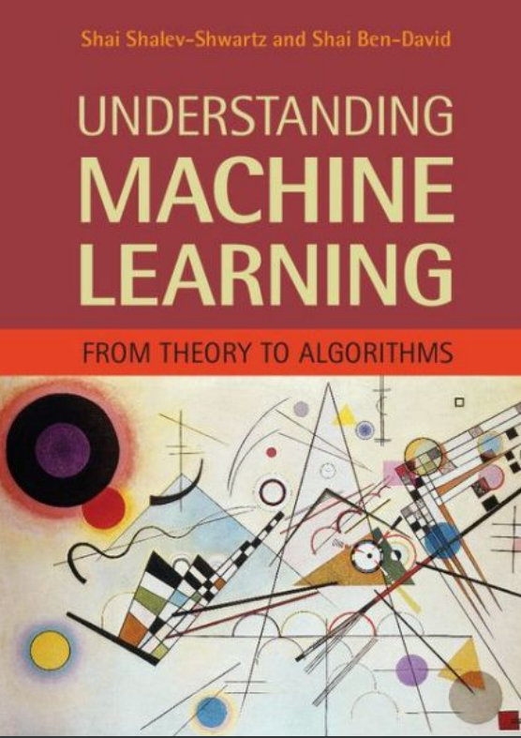
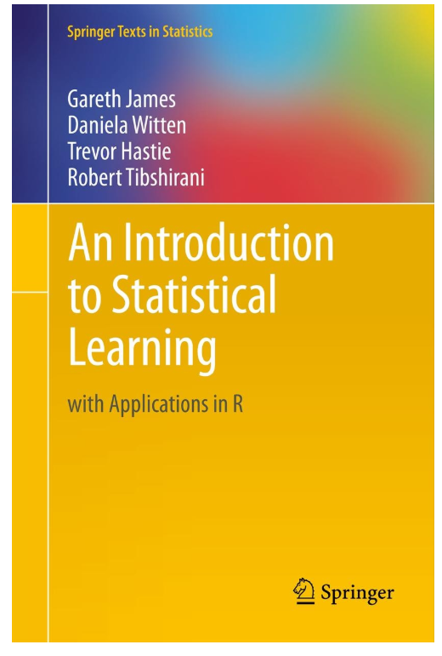
POLYNOMIAL REGRESSION : ADDITIONAL READING MATERIAL
Additional Resources, Page #126: http://www.cs.huji.ac.il/~shais/UnderstandingMachineLearning/understanding-machine-learning-theory-algorithms.pdf
Additional Resources, Page #266:
http://www-bcf.usc.edu/~gareth/ISL/ISLR%20Seventh%20Printing.pdf

